Slide 1
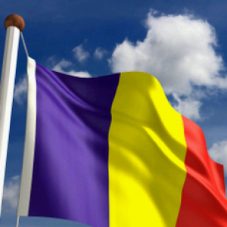
Welcome, dear guests!

Slide 2
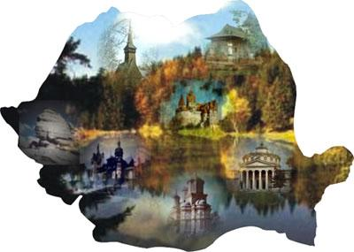
ROMANIA
Romania is a country situated in the South –East of Europe, with hardworking and welcoming people.
It is a country of great natural beauty and diversity and a rich cultural heritage. Romania enchants visitors not only with its scenic mountain landscapes and unspoilt rural areas, but also with its historic cities and its busy capital Bucharest.
Over the last decade, it has seen significant development and is one of the most recent members of the European Union.
Things for which our country is famous include the Carpathian mountains in the central part, the Black Sea with its fine sandy beaches and a necklace of resorts, the unique Danube Delta in Europe with lots of species of birds and animals and beautifully painted monasteries in Moldavia.
The tourists coming here find about our Constantin Brincusi, famous vineyards, medieval fortresses, Mircea Eliade, Dacia cars, Dracula, stuffed cabbage leaves, Nadia Comaneci, Gheorghe Hagi, sunflower fields and many others.

Slide 3
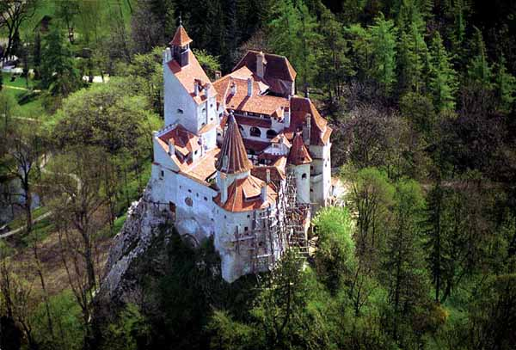

Slide 4
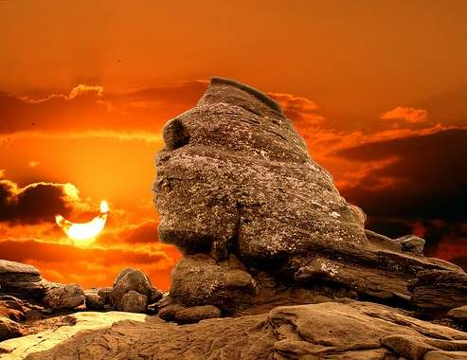

Slide 5
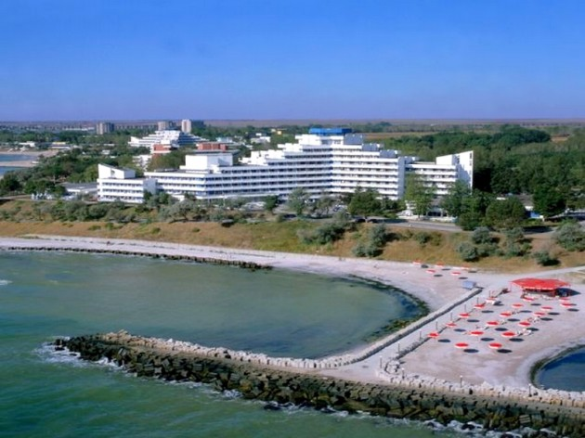

Slide 6
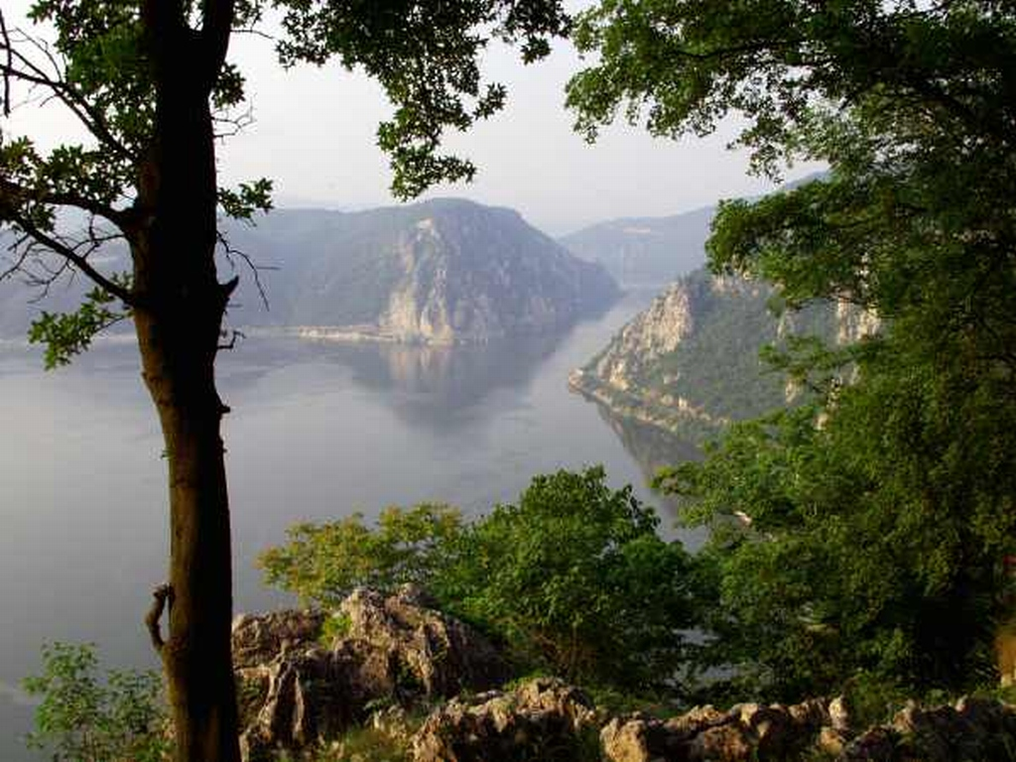

Slide 7
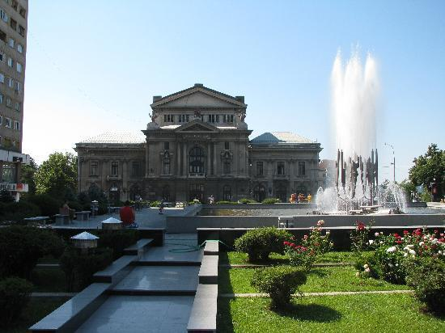
Drobeta Turnu-Severin
Drobeta Turnu- Severin located in the South –West of Romania, on the left bank of the Danube River that separates us from Serbia is a town full of history and romance. It is a mixture of modern and antique, of industrial and fairy with beautiful public gardens along the Danube and charming historical monuments that kept their authenticity along the time.
Drobeta Turnu- Severin, dubbed ‘the town of roses’, is full of parks adorned with lovely roses and tall walnut trees, that attract the tourists on their way to the famous hydroelectric plant ‘The Iron Gates I’,
Here visitors have the opportunity to see the medieval water castle, the History and Art Museum, the ruins of the medieval fortification, the ruins of Trajan’s bridge that crossed the Danube in the romans’ time.
People who visited Drobeta Turnu- Severin once, will not forget it and will come again.

Slide 8
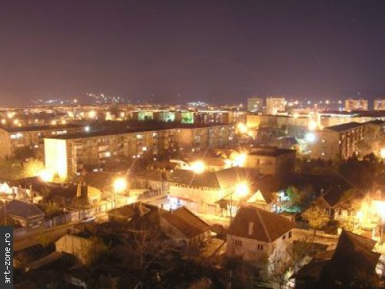

Slide 9
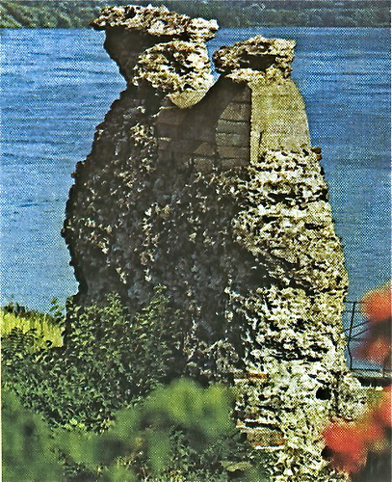

Slide 10
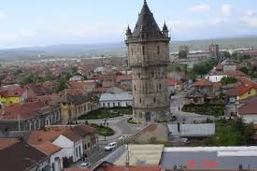

Slide 11
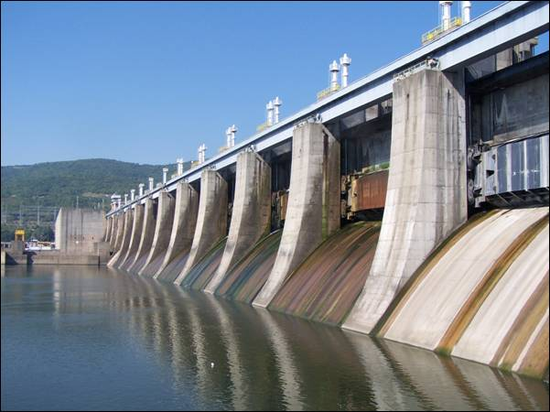

Slide 12
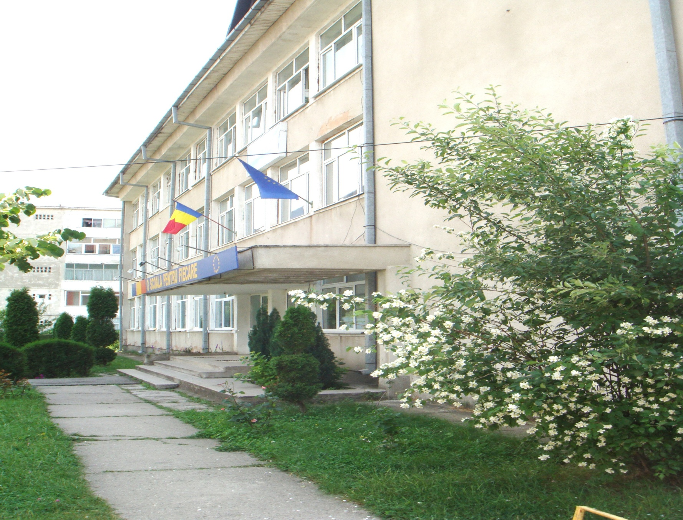
School number 14 is a large middle school located in the district Krihala, with about 750 students and 50 teachers.
In present our school is considered one of the best schools in Drobeta Turnu- Severin, with very good teachers and students, thing proved by the very good results obtained by our students at different contests and at the national exams.
The motto of our school is 'A school for everybody', and the instructive- educational process is organized in such a way, that when completing the eighth grade, the students have gained knowledge, competence and social values which could allow them to be integrated in the best high secondary schools in our town.
Our school has run several activities with European character (Comenius - multilateral projects, Lifelong learning courses, Spring Day, My Europe, Made for Europe, Mind the world, Echo- school with three prizes of 'The Green Flag') involving a great number of children, teachers and parents.
In a word we are proud of our school which becomes, day by day, well known in Drobeta Turnu-Severin.
School No. 14

Slide 13
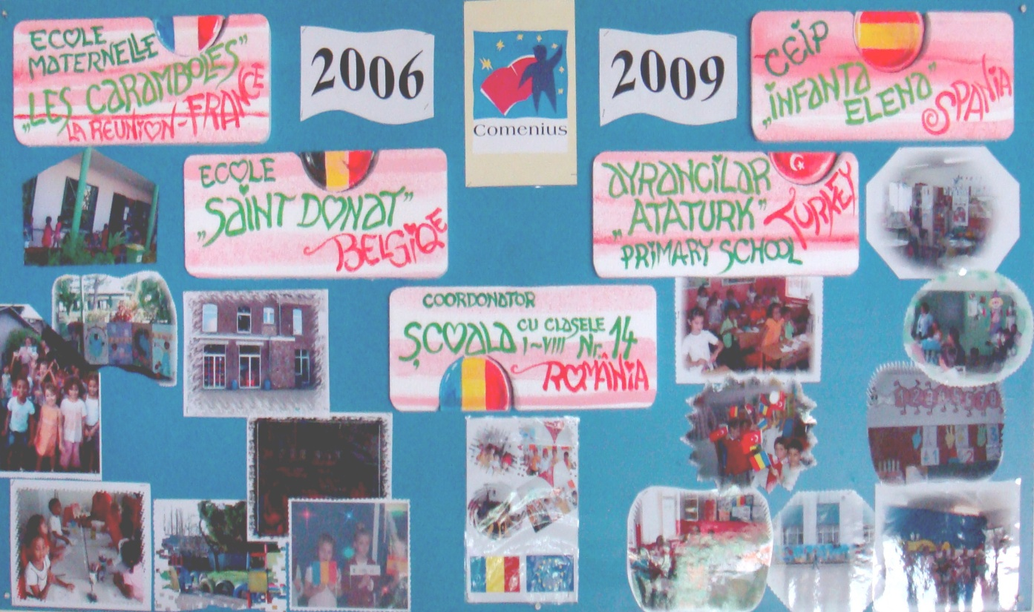

Slide 14
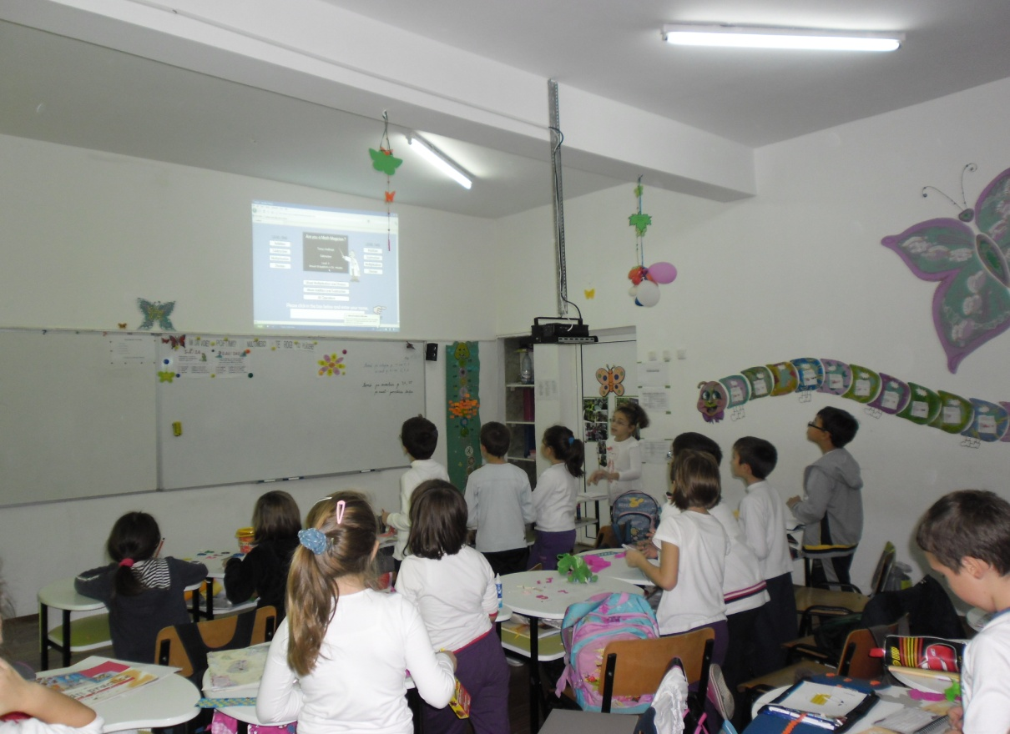

Slide 16
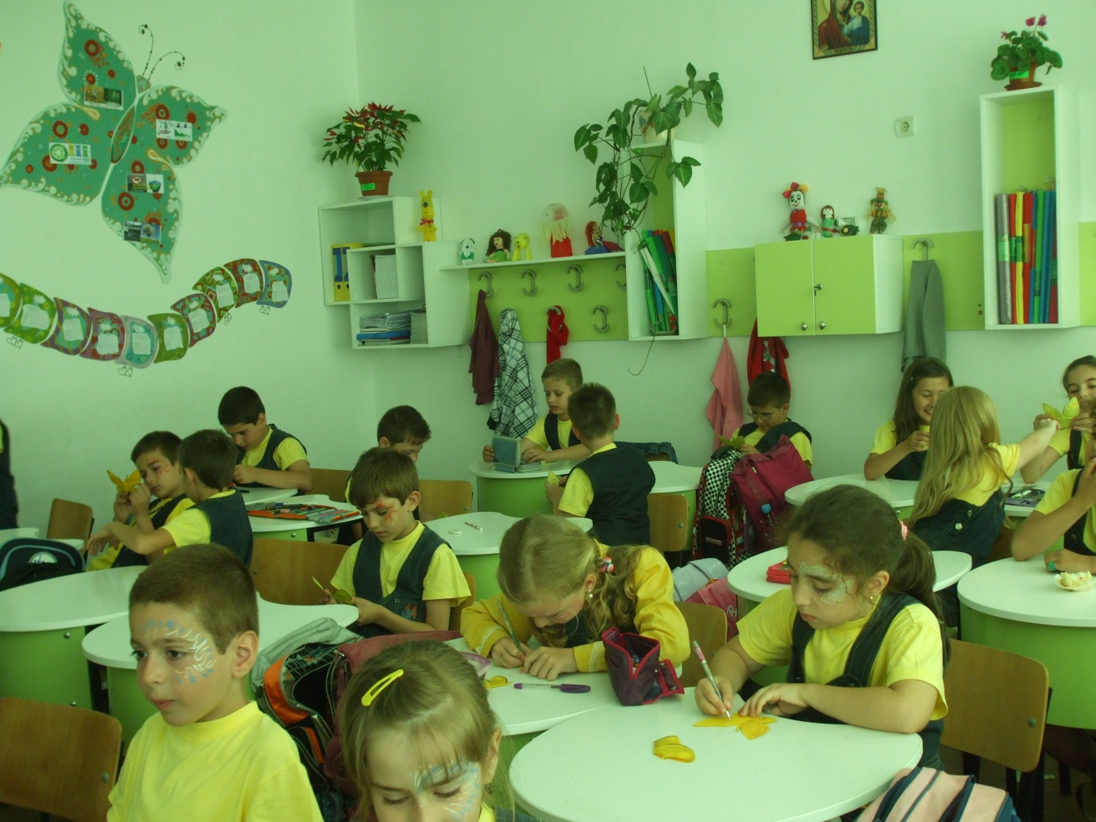

Slide 17
Smile with us,
please!

